Slide 1
Oxer
By Saim Adnan and Fuzail

Slide 2
THANKYOU!

Slide 3
Planning Phase
Purpose, Audience and Layout

Slide 4
Task 1
Audience:
The target audience is people who put in conscious efforts to maintain their health and appearance.
The webpage is lso directed towards people interested in exploring new ways to improve their lifestyle and pay more attention to their health.
Purpose:
The main purpose is to attract new members inordr to promote a healthy lifestyle and showcase the gym’s facilities.
This is also promoted so that peole can discover new aays to productively accumulate their free time.

Slide 5
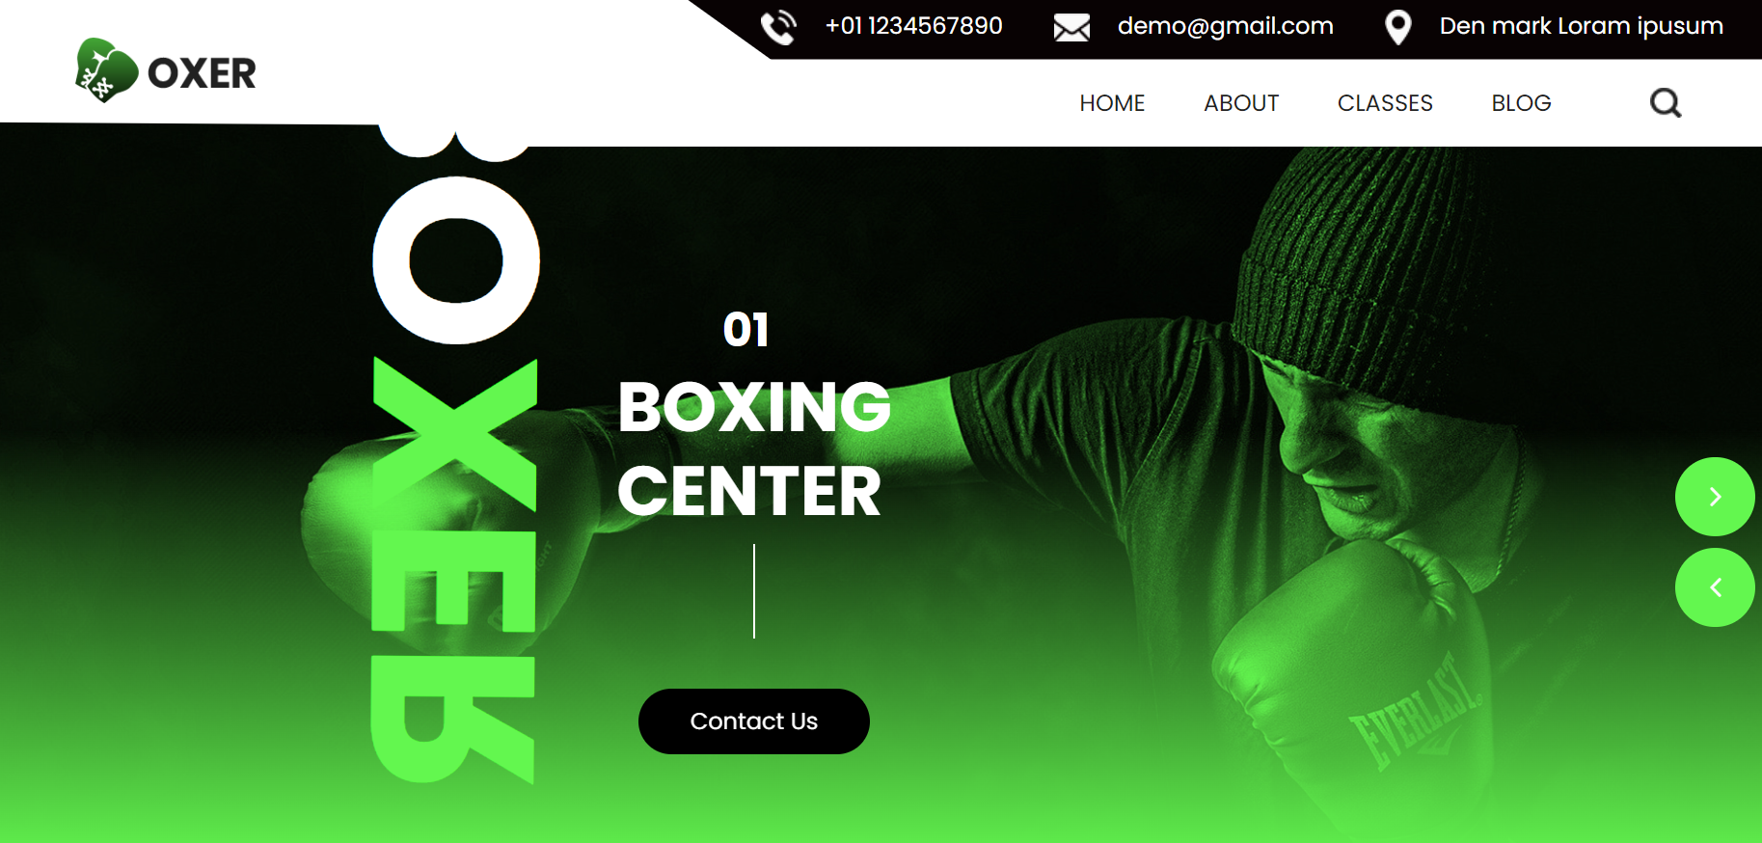
Task 2
Figma:
https://www.figma.com/file/1rLFfdOLytO9WNvR0GATLn/Untitled?type=design&node-id=1-4&mode=design&t=fSkyLF8ziIPvzy_0

Slide 6
Software Engineering Basics
project requirments, user stories

Slide 7
Features & Functionalities
Features:
The webiste introduces the users to the workd of boxing, allowing them to view it closely.
It provides some of the best training services.
Blogs & articles to increase awarness.
Classes
User Stories:
(a). I am a gym member and I want to participate in boxing tournaments.
(b)I am a beginner in the field of boxing and I want to learn more about boxing.

Slide 8
Frontend Development

Slide 9
Task
HTML:
Html is a coding language that allowed me to put forward my ideas in a presentable state on web.
CSS:
Css is the style sheet I used to make my website visually attractive by using featuress like colour gradients, image references and links.
JavaScript:
Javascript allowed me include interactive features in my website inorder to make it functional.

Slide 10
Github Repository
I uploaded all the files on Github as I continued to make tthe website, this allowed me track my progress as well as keep a presentable portfolio.

